Slide 1

Chapter 4 Network Layer:
Data Plane
Computer Networking: A Top-Down Approach 8th edition Jim Kurose, Keith Ross Pearson, 2020
Acknowledgement: Based on the textbook’s website: https://gaia.cs.umass.edu/kurose_ross/index.php
Notes:
Version History
8.0 (May 2020)
All slides reformatted for 16:9 aspect ratio
All slides updated to 8th edition material
Use of Calibri font, rather that Gill Sans MT
Add LOTS more animation throughout
added new 8th edition material on middleboxes (and Internet arch), Net neutrality, buffering …
lighter header font
8.2 (July 2023), changes from 8.0:
some minor updates (e.g., IPv6 stats updated) but not much has changed.

Slide 2

Network layer: “data plane” roadmap
Network layer: overview
What’s inside a router
IP: the Internet Protocol
Generalized Forwarding
Middleboxes
middlebox functions
evolution, architectural principles of the Internet

Slide 3
Middleboxes
IMPORTANT
Middlebox (RFC 3234)
“any intermediary box performing functions apart from normal, standard functions of an IP router on the data path between a source host and destination host”

Slide 4








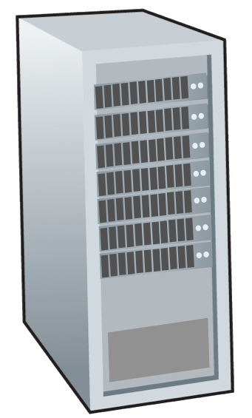







Middleboxes everywhere!
IMPORTANT
Firewalls, IDS: corporate, institutional, service providers, ISPs
national or global ISP
NAT: home, cellular, institutional
Load balancers: corporate, service provider, data center, mobile nets
Application-specific: service providers, institutional, CDN
datacenter
network
Caches: service provider, mobile, CDNs
enterprise
network

Slide 5
Middleboxes
IMPORTANT
initially: proprietary (closed) hardware solutions
move towards “whitebox” hardware implementing open API
move away from proprietary hardware solutions
programmable local actions via match+action
move towards innovation/differentiation in software
SDN: (logically) centralized control and configuration management often in private/public cloud
network functions virtualization (NFV): programmable services over white box networking, computation, storage

Slide 6
The IP hourglass
IMPORTANT
HTTP
SMTP
RTP
…
Internet’s “thin waist”:
one network layer protocol: IP
must be implemented by every (billions) of Internet-connected devices
QUIC
DASH
many protocols in physical, link, transport, and application layers
TCP
UDP
IP
Ethernet
…
PPP
PDCP
WiFi
Bluetooth
copper radio fiber

Slide 7
The IP hourglass, at middle age
IMPORTANT
HTTP
SMTP
RTP
…
QUIC
DASH
Internet’s middle age “love handles”?
middleboxes, operating inside the network
TCP
UDP
caching
NAT
IP
NFV
Firewalls
Ethernet
…
PPP
PDCP
WiFi
Bluetooth
copper radio fiber

Slide 8
Architectural Principles of the Internet
IMPORTANT
RFC 1958
“Many members of the Internet community would argue that there is no architecture, but only a tradition, which was not written down for the first 25 years (or at least not by the IAB). However, in very general terms, the community believes that
the goal is connectivity, the tool is the Internet Protocol, and the intelligence is end to end rather than hidden in the network.”
Three cornerstone beliefs:
simple connectivity
IP protocol: that narrow waist
intelligence, complexity at network edge

Slide 9
The end-end argument
IMPORTANT
some network functionality (e.g., reliable data transfer, congestion) can be implemented in network, or at network edge
application
transport
network
data link
physical
end-end implementation of reliable data transfer
application
transport
network
data link
physical
application
transport
network
data link
physical
application
transport
network
data link
physical
hop-by-hop (in-network) implementation of reliable data transfer
network
link
physical
network
link
physical
network
link
physical
network
link
physical
network
link
physical
network
link
physical

Slide 10
The end-end argument
some network functionality (e.g., reliable data transfer, congestion) can be implemented in network, or at network edge
“The function in question can completely and correctly be implemented only with the knowledge and help of the application standing at the end points of the communication system. Therefore, providing that questioned function as a feature of the communication system itself is not possible. (Sometimes an incomplete version of the function provided by the communication system may be useful as a performance enhancement.)
We call this line of reasoning against low-level function implementation the “end-to-end argument.”
Saltzer, Reed, Clark 1981

Slide 11




Where’s the intelligence?
20th century phone net:
intelligence/computing at network switches
Internet (pre-2005)
intelligence, computing at edge
Internet (post-2005)
programmable network devices
intelligence, computing, massive application-level infrastructure at edge
Notes:
The 20th century phone network had dumb network endpoints, really by definition. The end points were rotary phones that maybe only your parents and grandparents remember; they weren’t computers. They really were dumb devices, and therefore the phone network had programmable switches that were quite smart. All functionality – well, all of the intelligence - was implemented within the network. It HAD to be. The end systems could not do anything more than send digits and send audio signals.
When the Internet came along, the endpoints and the switches were both programmable computers. So where to put the complexity? RFC 1958 – the architectural principles of the Internet RFC - that says “intelligence is end to end rather than hidden in the network.” That puts the intelligence clearly at the edge, like we see here. And that’s possible because the edge devices are smart; they’re programmable. Well that’s the diagram as I remember it 20 years ago.
And in the 20 years since, as we see the rise of middleboxes and SDN, we’re now seeing intelligence (in software) layered on top of “dumb” whiteboxes within the network. So I might add a brain here today. And with datacenters and content distribution networks, we see even smarter and more sophisticated application-level infrastructure being connected at points within the network. So now there are clearly much much bigger, much more computationally intensive and complex, endpoints if you will in today’s Internet

Slide 12
Chapter 4: done!
Network layer: overview
What’s inside a router
IP: the Internet Protocol
Generalized Forwarding, SDN
Middleboxes
Question: how are forwarding tables (destination-based forwarding) or flow tables (generalized forwarding) computed?
Answer: by the control plane (next chapter)

